Slide 1
A History of the TeraGrid Science Gateway Program: A Personal View
Nancy Wilkins-Diehr
wilkinsn@sdsc.edu

Slide 2
Gateway Development Timeline
1990s
2000s
2010s
Mosaic released
Static HTML, CGI, Perl, Python, Java, Flash
1980s
BLAST server sends results by email
Still a working portal today
“PDB enhanced by Web browser”
10M web users (1993)
Gateway program begins (2003)
HTML5
Programmatic exchange between web pages
10 prototypes
100,000 CPU hours used
22 TeraGrid gateways
40M CPU hours used
1.8B web users
40% of TG users come through gateways
Supercomputer centers program begins
Web 2.0
User-generated content
NSF ITR program begins

Slide 3
First ITR projects natural fit for fledgling gateway program
5 year deliverables for these 10 projects
Pros
Practical, focused development of needed services in an unknown arena
Cons
Limits flexibility once infrastructure is developed
2 years into the project we were ready for allocated users
Linked Environments for Atmospheric Discovery (LEAD) (Droegemeier, U Oklahoma)
National Virtual Observatory (NVO) (Szalay, JHU)
Network for Computational Nanotechnology (Lundstrom, Purdue)
National Microbial Pathogen Data Resource (Stevens, U Chicago/ANL)
Building Biomedical Communities (Reed, UNC)
Neutron Science Instrument Gateway (Cobb, ORNL)
Grid Analysis Environment (Newman, Caltech)
Emergency Decision Support (Eubanks, LANL)
Real-Time Urban Flood Hazard Analysis System (Urban, U Texas)
Open Science Grid (Pordes, FNAL)
Linked Environments for Atmospheric Discovery (LEAD) (Droegemeier, U Oklahoma)
National Virtual Observatory (NVO) (Szalay, JHU)
Network for Computational Nanotechnology (Lundstrom, Purdue)
National Microbial Pathogen Data Resource (Stevens, U Chicago/ANL)
Building Biomedical Communities (Reed, UNC)
Neutron Science Instrument Gateway (Cobb, ORNL)
Grid Analysis Environment (Newman, Caltech)
Emergency Decision Support (Eubanks, LANL)
Real-Time Urban Flood Hazard Analysis System (Urban, U Texas)
Open Science Grid (Pordes, FNAL)

Slide 4
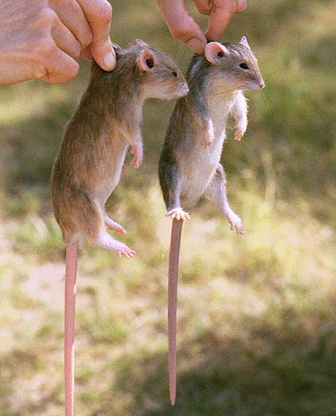
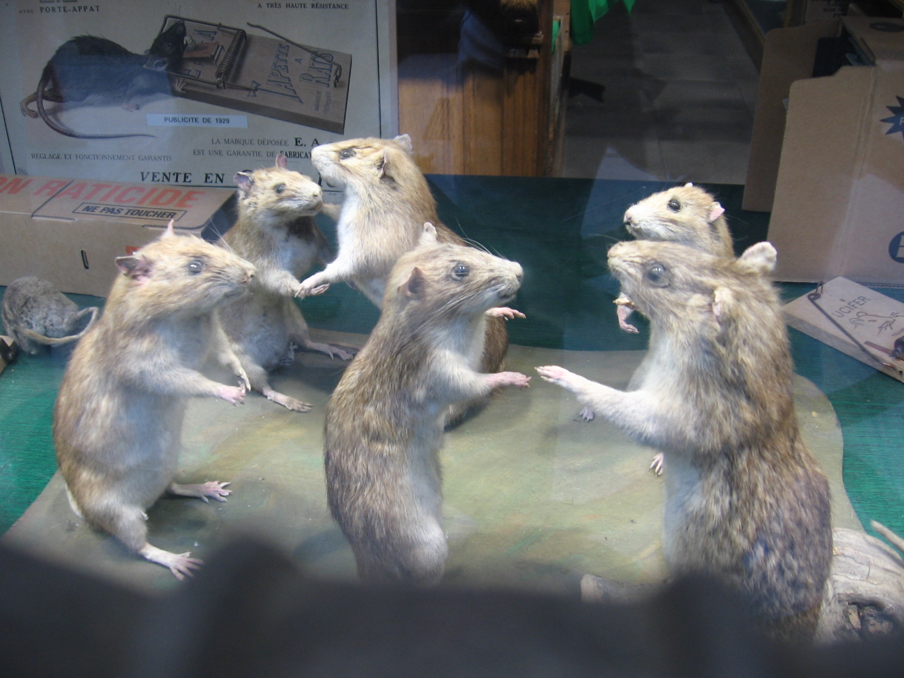
Next step, RATS of course
Requirements Analysis Teams
TeraGrid terminology for short-term teams formed to explore problems that spanned “working groups”
Gateway RAT was the first of these
Thanks Sebastien Goasguen
Extensive interviews with 10 initial projects over 2 months

Slide 5
RAT summary
Community allocations
Group accounts / limited privileges
Need for portal accounting capabilities, but little development
On-demand scheduling
Classifications (3 types)
Portals, desktop apps, access point to other grids
User model (3 modes)
Standard, portal, community

Slide 6
Actions for wg’s
tg-acctmgmt
Support for accounts with differing capabilities
Ability to associate compute job to a individual portal user
Scheme for portal registration and usage tracking
Support for OSG’s Grid User Management System (GUMS)
Dynamic accounts?
Current reflections
Community account model working well once we developed a system
When developing policies, need to maintain momentum and document what’s been agreed to
Didn’t do enough to facilitate use of OSG
Dynamic accounts were an interesting idea (Globus incubator) that didn’t pan out

Slide 7
Actions for wg’s
security-wg
Define open port ranges
Firewalls
Community account privileges
Need to identify human responsible for a job for incident response
Acceptance of other grid certificates
TG-hosted web servers, cgi-bin code
Current reflections
Community account request form
Security page for monitoring community accounts
Moved away review of individual cgi-bin code, gateway code
Provided tips on risk and vulnerability, how to set up a secure gateway
Talked about shutting off jobs from individual users, tools never developed
More general cert acceptance policies developed

Slide 8
Actions for wg’s (2)
Web Services (currently no wg for this)
Needs further study
Some Gateways (LEAD, NMBR) have immediate needs
Many will build on capabilities offered by GT4, but interoperability could be an issue
Web Service security
Interfaces to scheduling and account management are common requirements
Current reflections
Web service standards in flux at the time, being defined by Microsoft, IBM, Sun, HP, Oracle, W3C, Oasis and the then-named Global Grid Forum (now Open Grid Forum)
5 of 9 initial gateways interviewed expressed a need for web service interfaces
Push to move to Globus 4, with its WSRF interfaces, but no real developer uptake
Because of the lack of demand, TeraGrid never did develop widely used web interfaces to standard tasks like job submission and account management.

Slide 9
Actions for wg’s (2)
software-wg
Interoperability of CTSS and VDT for OSG
Software installations across all TG sites
Community software areas
portals-wg
Variety of approaches needs further analysis
OGCE, in-VIGO, Clarens, Neutron Science Tomcat+Apache
TG User Portal
Current reflections
Some requests foreshadowed the need for the Quarry virtual machine capabilities offered years later.
Resisted requests to overburden CTSS with individual software
Wanted TG to deliver simple solution that met the needs of many
Felt we had to evaluate every front-end portal approach, but really we did not
Could have done more to accommodate gateways with large data holdings

Slide 10
Gateways Primer Outline Basis for later documentation, thanks Anurag Shankar
1. Introduction
2. Science Gateway in Context
a. Science Gateway (SGW) Definition(s)
b. Science Gateway user modes
c. Distinction between SGW and other TeraGrid user modes
3. Components of a Science Gateway
a. User Model
b. Gateway targeted community
c. Gateway Services
d. Integration with TeraGrid external resources (data collections, services, …)
e. Organizational and administrative structure
4. TeraGrid services and policies available for Science Gateways
a. Portal middleware tools (user portal and other portal tools)
b. Account Management (user models, community accounts, )
c. Security environment (security models)
d. Web Services
e. Scheduling services (and meta-scheduling)
f. Community accounts and allocations
g. Community Software Areas
h. All traditional TeraGrid services and resources
i. Ability to propose additional services and how that would interact with TeraGrid operations
5. Responsibilities and Requirements for Science Gateways
a. Interaction with and compatibility with TeraGrid communities
b. Control procedures
i. Community user identification and tracking (map TeraGrid usage to Portal user)
ii. Use monitoring and reporting
iii. Security and trust
iv. Appropriate use
6. How to get started
a. Existing resources
i. Publication references
ii. Web areas with more details
iii. Online tutorials
iv. Upcoming presentations and tutorials
b. Who to contact for initial discussions
c. How to propose a new Gateway
d. How to integrate with TeraGrid Gateways efforts.
e. How to obtain a resource allocation

Slide 11
2 years in, we’re ready for production
Production-quality infrastructure and services
Ready to support allocated users
Front-end development funded and performed by science communities
TeraGrid staff provide back-end integration and TG-specific support
Help desk gateway expertise as well as longer term collaborations
But, we begin to see early examples of sustainability challenges
What about the initial 10 projects?
Many remained production gateways
Some did not pan out due to lack of source code access
Others did not pan out as originally envisioned, but led to other useful capabilities like SPRUCE
Still others foreshadowed the need for services like the Quarry gateway hosting service

Slide 12
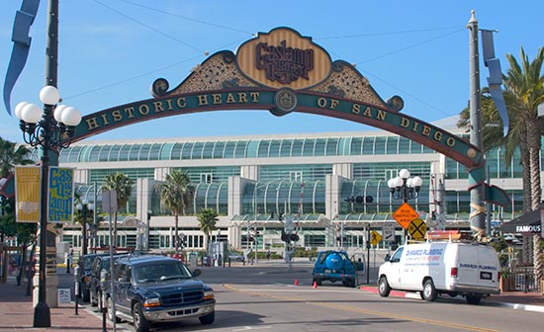
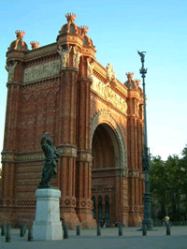
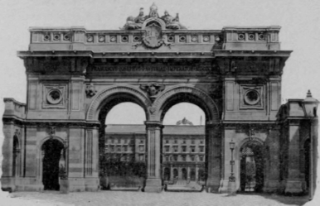
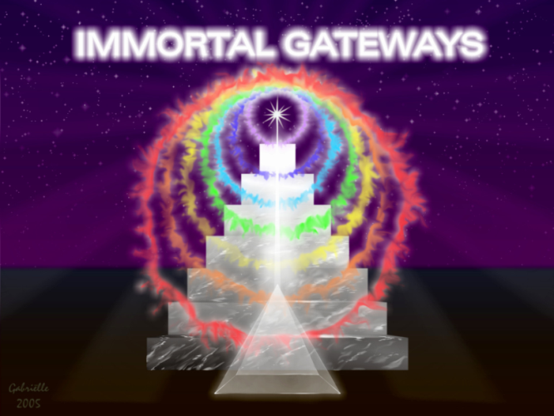

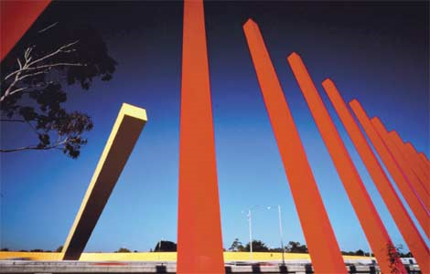

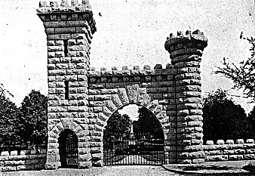
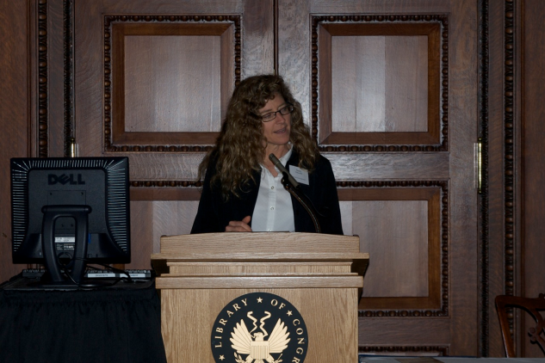
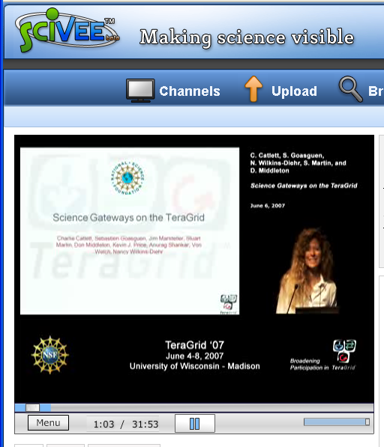
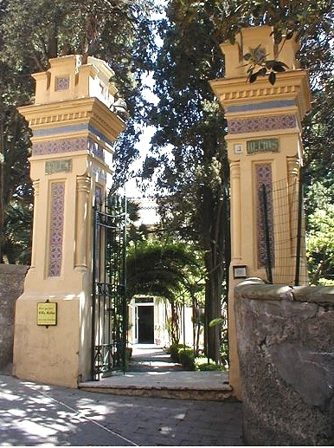
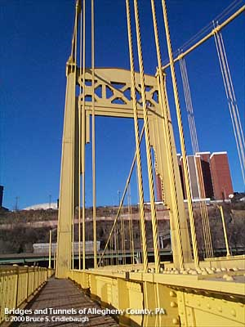
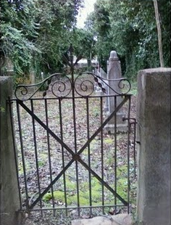
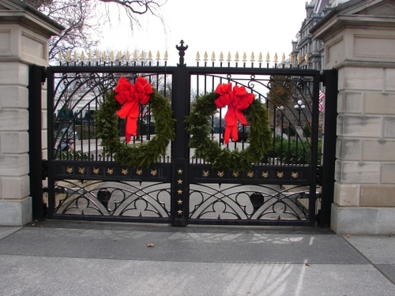
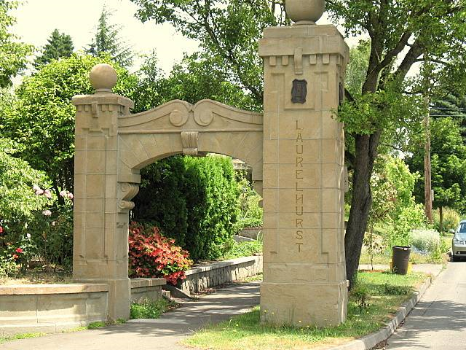
7 years of gateway talks
Notes:
DC, Paris, Melbourne, Barcelona, Vienna, Beijing, San Diego, Pittsburgh, Vegas, Civil war cemetery in Arkansas, Washington DC

Slide 13
How to build a gateway in a day

Slide 14
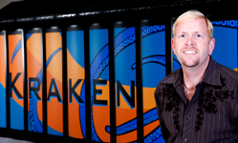
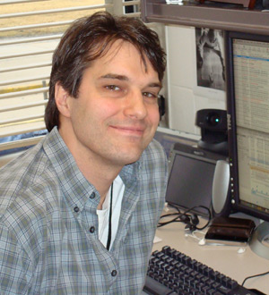
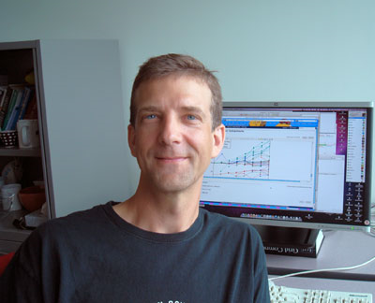


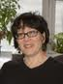
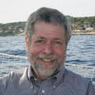
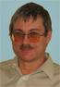



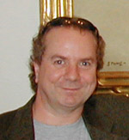
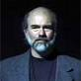
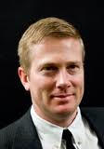


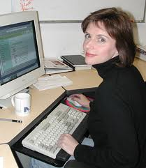
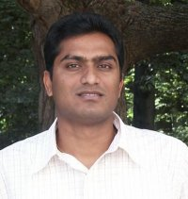
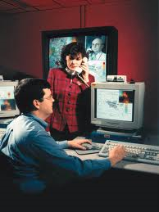

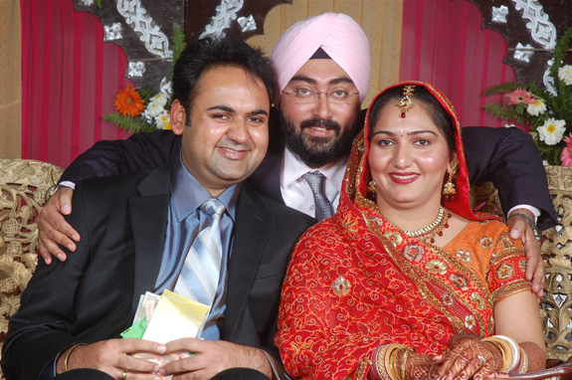
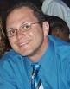
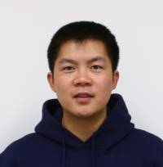

7 years of great staff – thank you!!

Slide 15
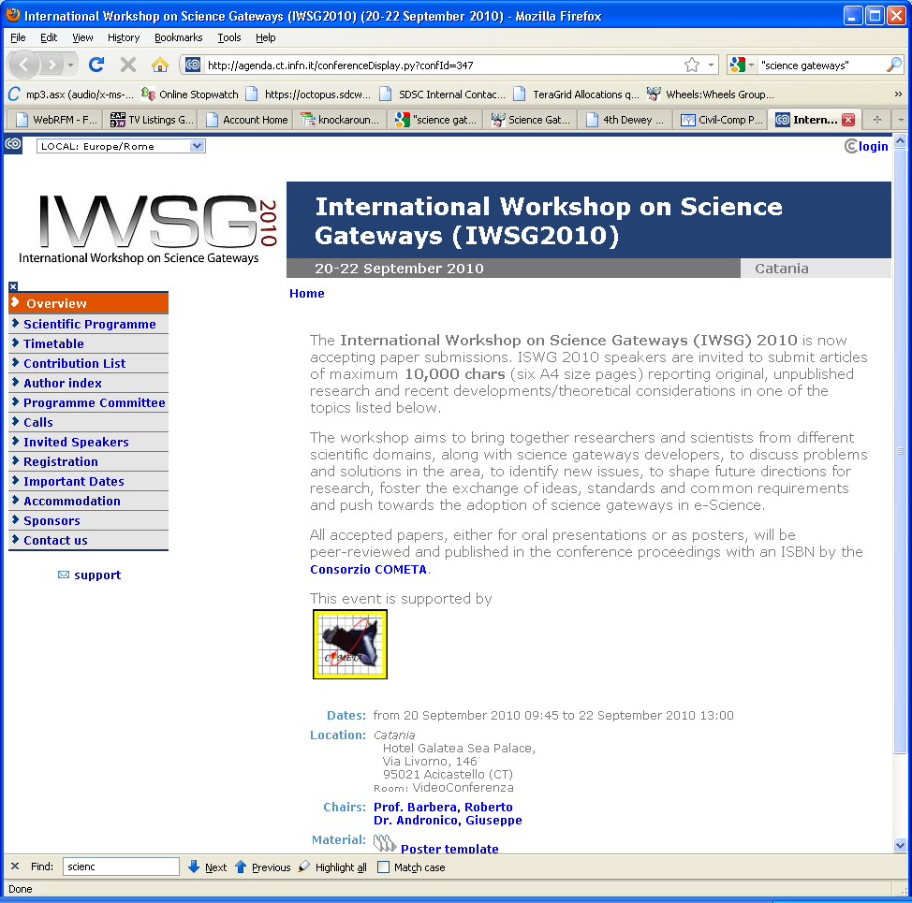
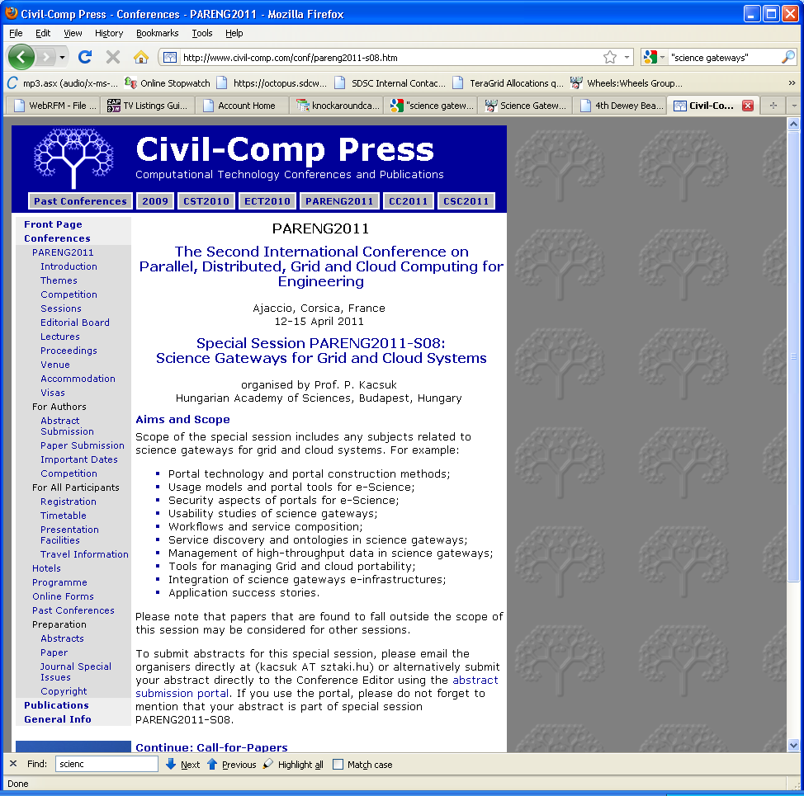
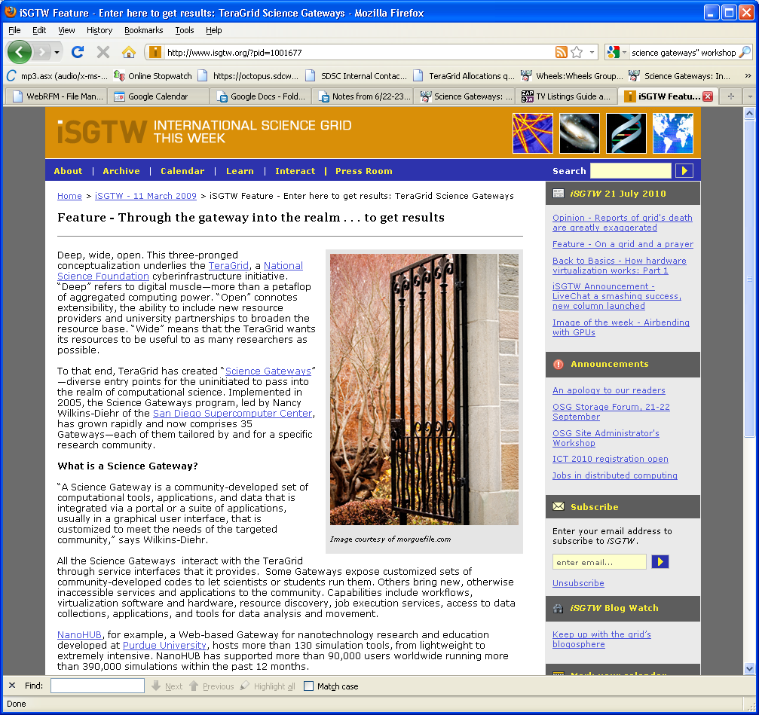
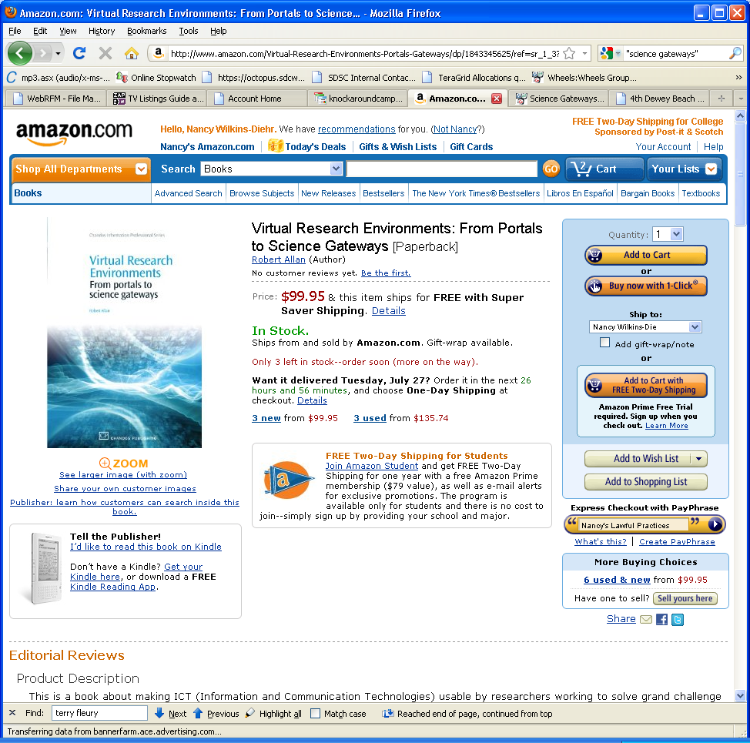
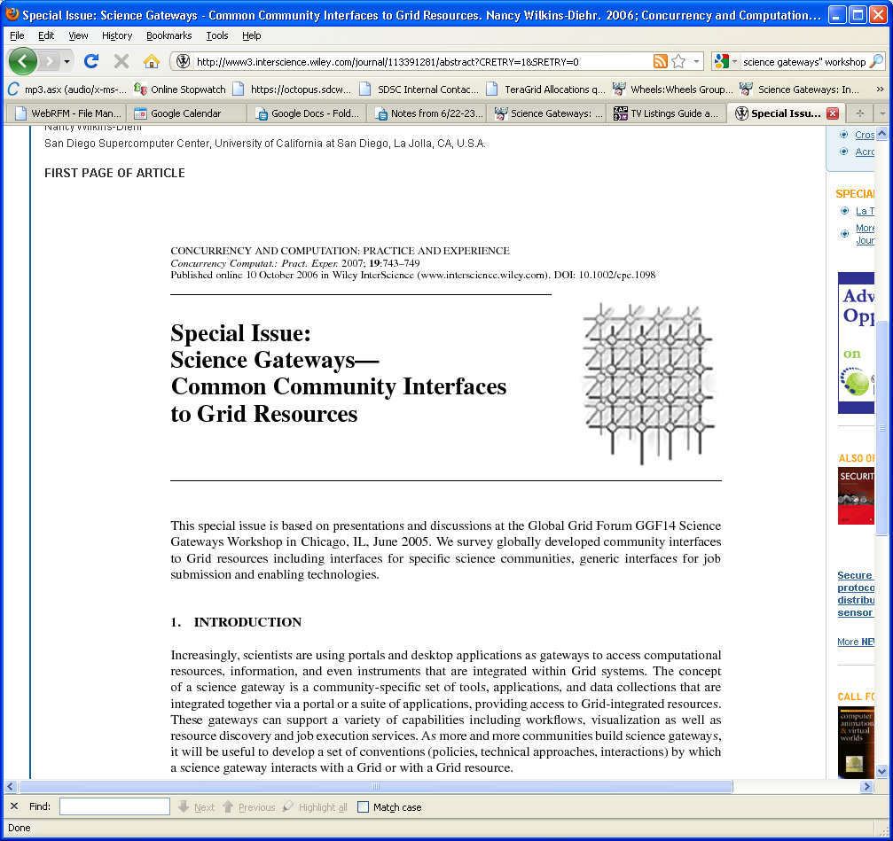
Worldwide gateway activities

Slide 16

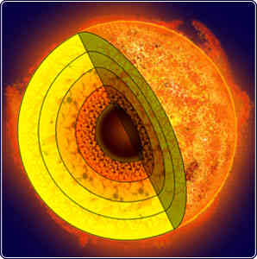
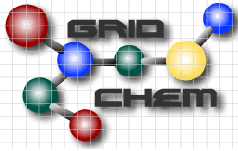




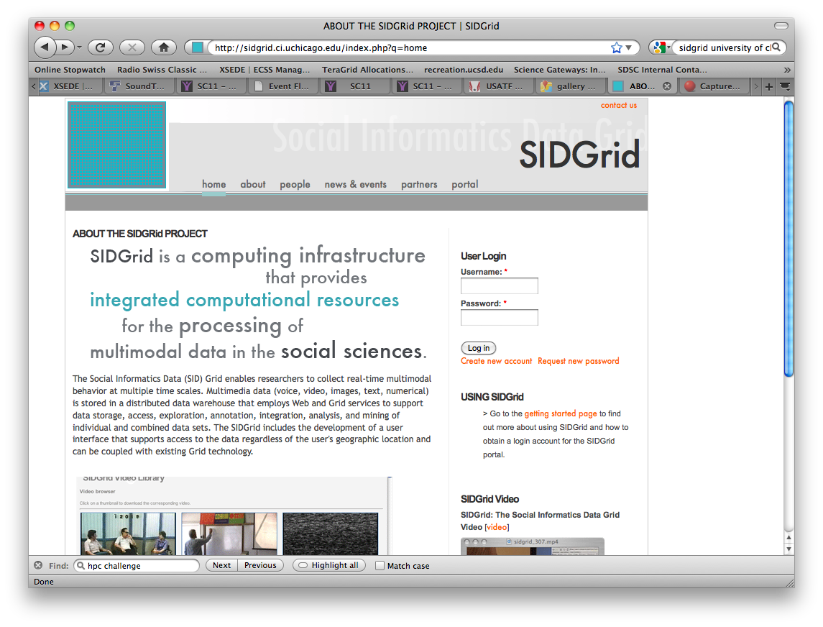






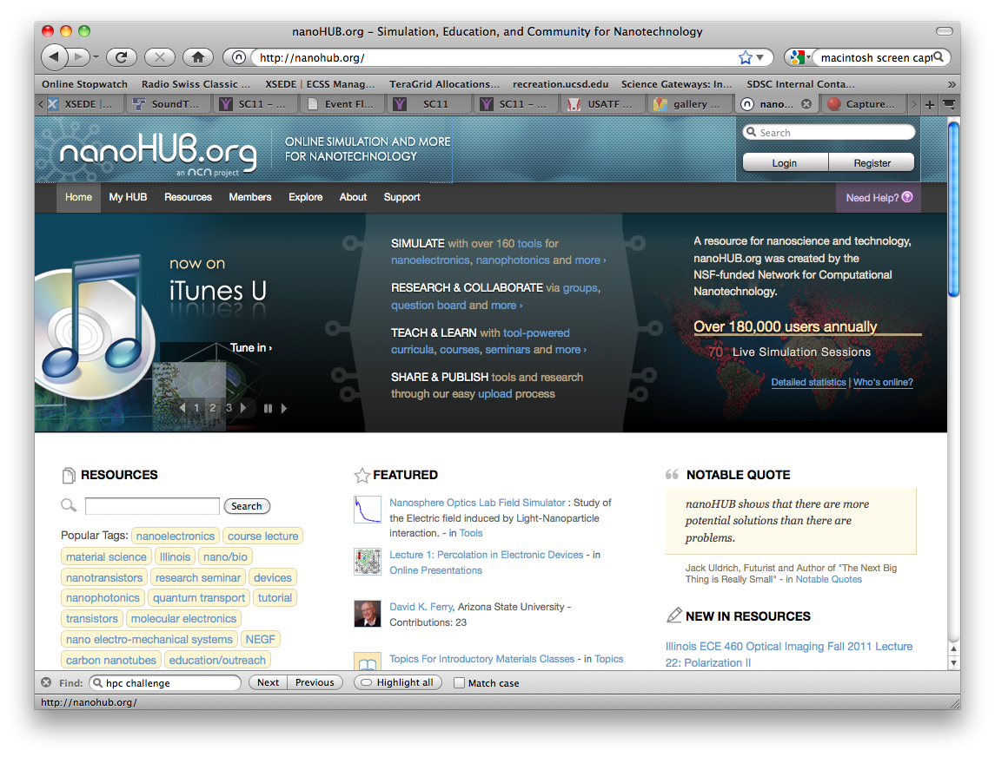
7 years of gateways
Notes:
C4E4
online model simulations of SWAT (Soil Water Assessment Tool) and HRLDAS (High Resolution Land Data Assimilation System)
Future work for this gateway, includes incorporation of remote sensing from sources such as the National Climactic Data Center, the USGS, the United States Historical Climatology Network and the Climate Prediction Center
CCSM
gives students and researchers hands-on access to a world-class, sophisticated climate code
portal was used in a graduate course in 2009, “Models in Climate Change Science and Policy” (Huber), educate students in the use and misuse of modeling across disciplines
students generated policy recommendations based on their own analysis of output from a suite of scientific, economic, and political models of climate change impacts
LEAD
Mesoscale weather, launching HPC simulations as a result of radar feeds, team very active in reliability improvements after student Weather Challenge
GridChem
Nice, production resource for computational chemists
Leading in software deployment, scheduling
Nice work chaining multiple codes
work that you don’t want each scientist re-doing for themselves
Parameter studies
SIDGrid
Only social science gateway using TG
Unique multi-modal datasets
Images, audio, video, biological data
Collaboration, annotation
Allows students from multiple disciplines to “speak the same language” for a U Chicago course
Nice work by development team on gadgets
NVO
Clarens, cgi-bin needs foreshadowed need for Quarry gateway hosting
ESG
- 20,000 users, used by World Climate Research Program (WCRP) and the Intergovernmental Panel on Climate Change (IPCC)
Connection between ESG and CCSM, also importance of metadata, reproducibility. Necessity of this when policy decisions depend on simulations.
Neutron Science
Connection to an instrument
Changing how scientists work, this community used to taking home data on disks
RENCI bioportal
Nice emphasis on web services
140 apps maintained across platforms, nice distribution mechanism
Award for most innovative grid app in life sciences in 2006
Condor Glide-ins, OSG
Did some nice work on automated software listing
But fell victim to sustainability issues, no longer a functioning portal
SCEC
Nice example of a gateway designed for a small number of high end scientists to manage complicated workflows
Mix of large, scalable codes and hundreds of thousands of independent runs
Probabilistic Seismic Hazard Analysis (PSHA) map for California
Created from Earthquake Rupture Forecasts (ERC)
~7000 ruptures can have 415,000 variations
CIPRES
Most used gateway in XSEDE
Accounts for 25% of all TG users charging jobs
17 EPSCoR, 6 continents
Pushing the envelope on allocations, allocations policies, charging personal allocations
nanoHUB
Very successful, over 100,000 users, impacting science, tenure processes
Template for other HUBs (HUBzero)
Ease of use, reliability, closest to an industry-quality experience
Ultrascan
Large userbase (2000)
Uses resources internationally
Connection to instrument
Used Quarry to set up test instance of gateway
Used fault tolerance lessons-learned in LEAD
ESMF
Unique coupling of desktop hydrology code and climate code on supercomputer
Will push XSEDE in unique ways
Working on prototype for security evaluation
CyberGIS
Unique opportunity to affect many communities because of applicability of GIS to so many domains
Food supply, wildlife migration, land use, public health
Provided high profile visibility to TeraGrid and gateway program at 2010 UCGIS meeting at Library of Congress
GIO Department of Interior, Acting Chair Federal Geographic Data Committee, Assistant Secretary for Policy Development and Research, HUD, Special Assistant to the President for Urban Affairs, CIO, EPA, GIO, Department of Agriculture.
Biodrugscreen
Provides data and scoring function tools for drug-like molecules with protein targets from the Protein Data Bank.
allows drug researchers to develop their own scoring functions
pulls from a database and performs more intensive computations than one could achieve on a desktop
iData
- General purpose gateway to self-publish datasets
File and table-based data
metadata support, condition and key word queries and data upload, download, modification, exploration, access control and usage reports.
Enables individuals, included mentoring of MSI students
Expressed Tag Sequence
Next gen sequence data
Complex analysis pipelines with run times from milliseconds to days
Benchmark tests on up to 2M sequences

Slide 17
Gateway Program Infrastructure Highlights
Quarry
Helpdesk
Contributions to stable grid environment
Attribute-based authentication
Career development
Experience as incubator project with Apache

Slide 18
Gateway Program Lessons Learned
Start with a focused set of customers
Develops strong foundation for the program
But be ready for evolution
In our case this evolution was an expanded mission to help other projects once we had a working infrastructure
This was a turning point in the program, focus on backend integration added clarity
Documentation, tutorials, prebuilt VMs so others can help themselves
Diversity of domains provided a unique opportunity for developers to interact
Used project telecons to bring in interesting, relevant speakers
Don’t be distracted by requirements where there is a very small user base
Sometimes difficult to identify these a priori
Document achievements so issues are not revisited
Do few things, but do them well
Takes a lot of momentum to create change, especially in a distributed environment
Sometimes if you try to do too much, nothing will get achieved
Exemplar projects show others that this can actually work for them too

Slide 19
What makes a successful gateway: lessons learned
Close contact with user community
Many times hiding the fact that HPC is used is the best route
Meet a defined need
If you are the only one who provides a good service that is in high demand, users will put up with a lesser quality interface
But seeking to improve the UI isn’t a bad idea either
Reliability
Simplicity, easy to maintain
Dynamic leader who is almost entrepreneurial
Must constantly look for ways to improve the product, meet user needs, attract funding

Slide 20
Future Work
Continue to make the high end accessible in XSEDE
Keep barrier to entry as low as possible for gateways
Make cloud computing resources available to gateways
Immediately available resources could nicely fit the gateway usage model
Gateway development environment
Research vs infrastructure
Development vs operations
Rewards and recognition in an academic environment
Sustainability
Many good projects come and go
Researchers will not trust gateways for their science if they are not persistent
How to identify the good gateways so they can be funded sustainably

Slide 21
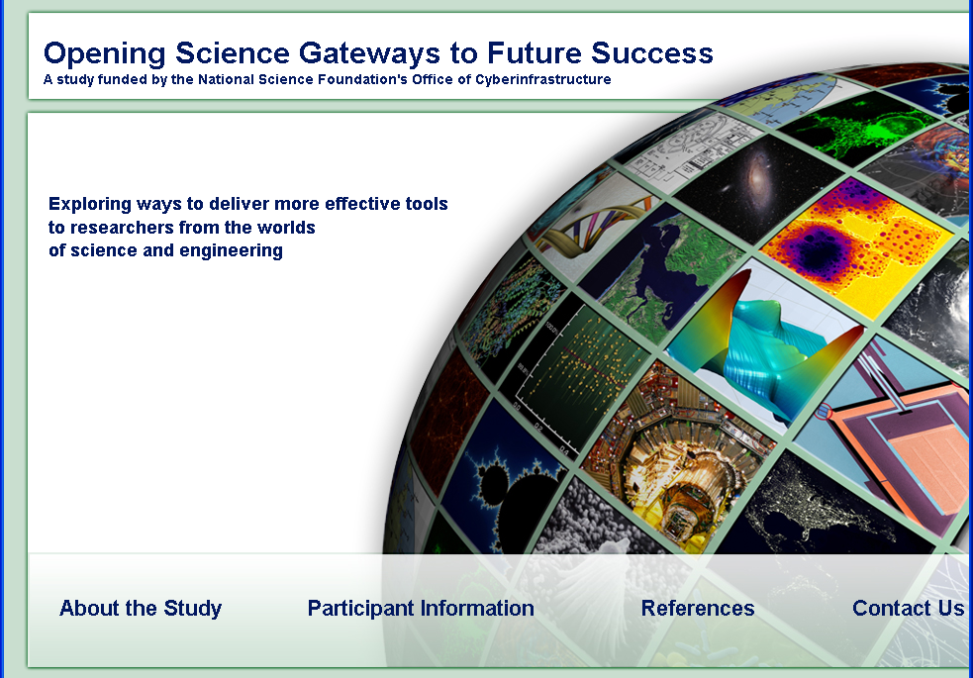
How can gateways be even more successful?
Need to be persistent in order to build
How to fund projects that are really making an impact for the long term?
Tensions include
Research vs infrastructure
Development vs operations
Academic reward systems
But, things are changing

Slide 22
Now for a look at real future work Terrific program in store today
Security
Apache efforts
Gateway building approaches
Several domain gateways

